Slide 1
BACS Web Query Processor
A project by
Ravi Kumar & Sarang Deshpande

Slide 2
BACSWQP – Project Overview
BACSWQP is an AI-powered web application that enables authorized users to retrieve data from the Biometric Access Controller System (BACS) database using natural language queries.
Instead of writing SQL queries, users simply type questions in plain English, and the system automatically:
Converts the question into SQL
Executes it on Microsoft SQL Server
Returns a clear, human-readable response
Exports large datasets to Excel when required
The system operates entirely on the internal campus network with no internet dependency.

Slide 3
Problem & Solution
The Problem
Many users require frequent access to BACS data for many reasons
But most users lack SQL knowledge required to access this data
Giving direct database access to users creates security risks
The Solution
BACSWQP introduces an intelligent AI query layer that:
Eliminates SQL knowledge requirement
Enforces strict domain validation
Allows read-only, secure access
Maintains full logging about

Slide 4
System Architecture & Technology
Architecture Overview
The system consists of:
Web Frontend (HTML, CSS, JavaScript)
FastAPI Backend Server
Query Processing Engine
Microsoft SQL Server
Two locally deployed AI models
Technology Stack
Backend
Python 3.x
FastAPI & Uvicorn
Pyodbc
Pandas
AI Inference
Llama.cpp
GGUF quantized models
The application runs on a GPU-enabled server for optimized AI inference.

Slide 5
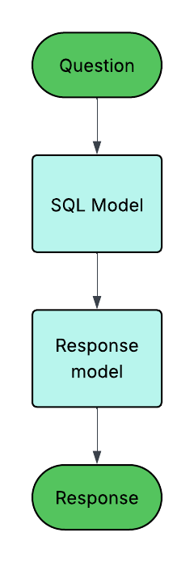
AI Model Strategy & Optimization
Dual-Model Design
SQL Generation Model
Llama 3.2 8B Custom Fine-Tuned (GGUF)
Converts natural language into optimized SQL
Response Generation Model
DeepSeek R1 Distill (GGUF)
Converts SQL results into human-readable explanation
Model Optimization
Original fine-tuned model size: ~30 GB
Reduced to ~14 GB (16-bit)
Final deployment size: ~4 GB (4-5 bit GGUF)
This enables both models to run within 12 GB GPU memory.

Slide 6
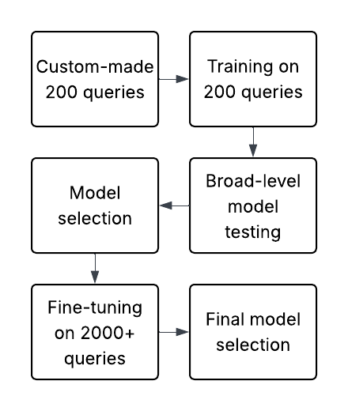
Custom Dataset & Training Effort
Dataset Development
Initial 200 complex SQL–Question pairs
Expanded to 2,000+ domain-specific examples
Fully tailored to BACS database schema
Included multi-table joins, logs, reporting, permissions
Fine-Tuning Approach
LoRA-based fine-tuning
Domain vocabulary adaptation
SQL rule enforcement
Query optimization patterns
This dataset development required several months and was the most critical phase of the project.

Slide 7
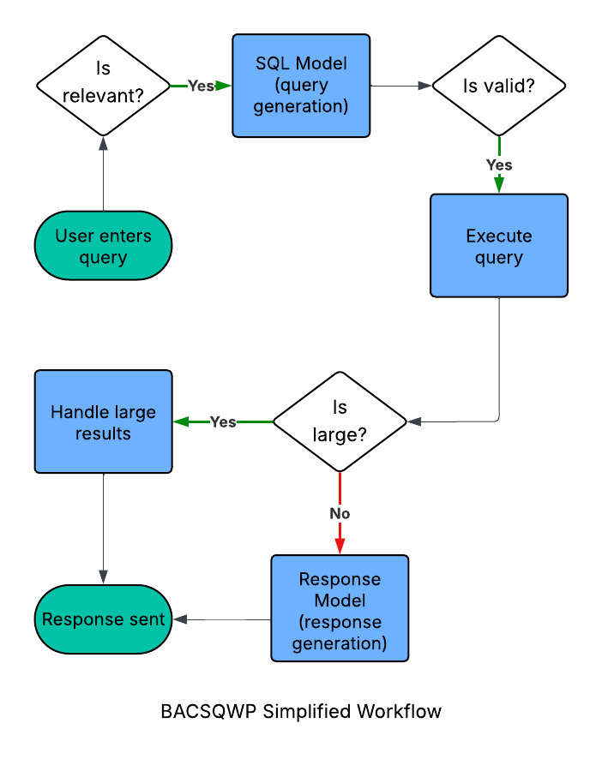
Processing Workflow
The workflow of query processing is:
User submits natural language query
System validates domain relevance
SQL generated by LLM
SQL validated (syntax & security)
Query executed on SQL Server (read-only)
Results analysed
Response generated OR Excel file exported
Response streamed in real time
Average full processing time: 30-40 seconds

Slide 8
Performance & Constraints
Performance Metrics
SQL generation: 15-20 seconds
Response generation: 15-20 seconds
Database execution: <5 seconds
90% of queries completed within target thresholds
Hardware Constraints
NVIDIA RTX 3060 (12 GB vRAM minimum)
Sequential query processing (GPU memory limitation)
Models consume full GPU memory when loaded
The system supports multiple sessions but processes queries one at a time.

Slide 9
Security & Control Mechanisms
The system was designed with strong security controls:
Internal network only (no internet access)
User authentication required
Strict domain relevance validation
SQL injection prevention
Read-only SELECT queries enforced
Full query logging with timestamps and user ID
Encrypted database credentials
No INSERT, UPDATE, DELETE, or schema modification allowed.

Slide 10
Conclusion
BACSWQP successfully delivers:
AI-powered natural language database querying
Secure and validated SQL generation
Custom-trained domain-specific models
Optimized deployment within hardware constraints
Reliable, internal enterprise-grade system
It acts as a secure intelligent bridge between users and the BACS database, combining AI capability with enterprise-level control.

